Slide 1
Wireframe for website A17_6 slide 2 – homepage - Oreoluwa slide 3 – healthpage and fitness page - Naysharn slide 4 – mental health page - Qamar slide 5 – review page - jensen slide 6 - contact us page - keros *created and reviewed by team leader : Mahin *
Will be discussed in next meeting.

Slide 2
Logo
Navigation bar
Homepage wireframe, created by oreoluwa, we just need to add a navigation bar everything.
Will we have any text on homepage?
**
Reviewed by team leader, Mahin✅
**
Homepage
Hyperlinks that link to other pages
Pictures
Pictures
Dropdown buttons

Slide 3
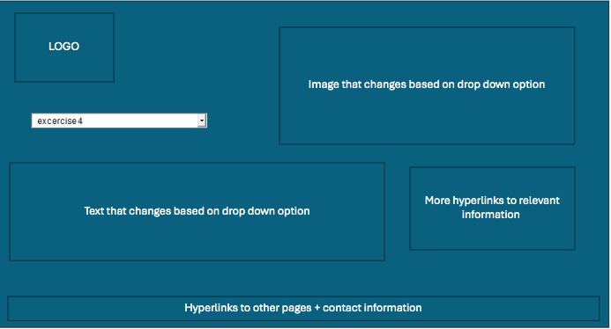
Health page wireframe, created by Naysharn, well layed out, we just need to add a title for the page so users know which page they are accesing.
Will we be using different background colors for different pages or same?
*To discuss in team meeting*
**
Reviewed by team leader, Mahin✅
**

Slide 4
Logo
Border
Qamar Iqbal Gutierrez
navBar
Mental Health
Physical Health
…….
Mental Health page wireframe, created by Qamar, nav bar done very nicely.
Will we be using different background colors for different pages or same?
*To discuss in team meeting*
Will be have images, text, tables , statistics?
*To discuss in team meeting*
**
Reviewed by team leader Mahin✅
**
navBar2
Mental Health
Will be have images, text, tables , statistics in this open space?​
*To discuss in team meeting*
footer

Slide 5
Add logo
Main Page Mental health Fitness effects Review page Contact page
Stock image
Review page wireframe, created by Jensen, very well layed out.
Do we need to add anything else to this page?
*To review at team meeting*
**
Reviewed by team leader, Mahin✅
**
Text talking about reviews
Note: Slides off page to next review dependant on arrow pressed
Picture
Review
Name
Green bar with review stars
Footer

Slide 6
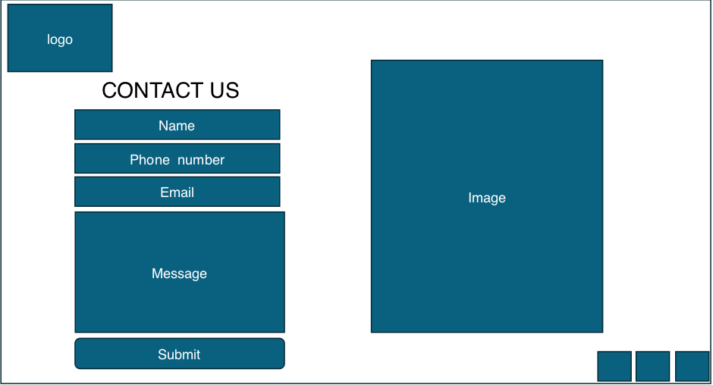
contact us page wireframe, created by Keros, very well layed out.
Do we need to add anything else to this page?
*To review at team meeting*
**
Reviewed by team leader, Mahin✅
**

